Slide 1

Industrial Training Seminar
On
Python & Data Science
Submitted By-
Deepanshu
517/23
Submitted To-
Mr. Navam Sir

Slide 2
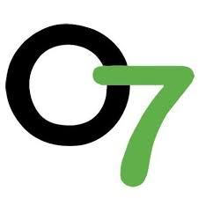
Company Profile
• Certification: ISO 9001:2015 Certified
• Specialization:
Web Development
Mobile Application Development
Custom Software Development
UI/UX Design - Hosting Services
Digital Marketing
• SERVICES:
Advance IT solution supporting the entire business
Consulting to system acdevelopment
Deployment
Quality Assurance
24x7 Support
Headquarters : Jalandhar
Branch Office : Hoshiarpur

Slide 3
Tabble Of Content
Introduction to Python
Why Python for Data Science
Python vs Other Languages
Libraries (NumPy, Pandas, Matplotlib, Seaborn)
Comparison ( Matplotlib & Seaborn )
Streamlit
Future Jobs Using Python + Data Science

Slide 4
Introduction To Python
High-level, interpreted, and beginner-friendly language
Simple syntax and highly readable code
Free, open-source, and cross-platform
Vast standard library and third-party ecosystem
Widely used in Data Science, AI, Web Development, and Automation

Slide 5
Why Python For Data Science
Simple & beginner-friendly language
Extensive libraries for analysis & visualization
Widely used in Machine Learning & AI
Open-source, free, and cross-platform
Huge community and industry adoption

Slide 6
Python vs Others Languages
Language | Python | Other Language
Java | Concise, beginner-friendly, fewer lines of code | Verbose, faster execution, widely used in enterprise software
C++ | Simple syntax, dynamically typed, slower execution | Complex syntax, compiled (faster), used in gaming & systems
R | General-purpose, great for ML, AI, web, and data science | Specialized in statistics & visualization, used by statisticians
JavaScript | Strong in AI, Data Science, backend development | Strong in frontend & backend web development, runs in browsers

Slide 7
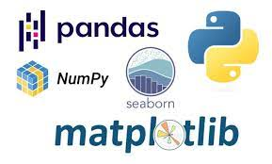
Python Libraries For Pandas

Slide 8
NumPy
Provides support for multidimensional arrays and matrices.
Offers fast mathematical functions (linear algebra, statistics, etc.).
Foundation library for scientific computing in Python.
Works seamlessly with Pandas, Matplotlib, and ML libraries.

Slide 9
Pandas
Provides DataFrame and Series objects for data handling.
Easy data cleaning, transformation, and analysis.
Supports operations on structured data (CSV, Excel, SQL).
Widely used for preprocessing before visualization or ML.

Slide 10
Matplotlib
Core library for creating 2D plots and charts.
Supports line, bar, scatter, histogram, and pie charts.
Highly customizable (colors, labels, styles).
Basis for many other visualization libraries (like Seaborn).

Slide 11
Seaborn
Built on top of Matplotlib for simplicity.
Creates attractive statistical plots (heatmaps, boxplots, etc.).
Great for correlation and distribution analysis.
Provides easy themes and color palettes.

Slide 12
Comparison Between Matplotlib & Seaborn
Aspect | Matplotlib | Seaborn
Purpose | General-purpose plotting library | Statistical data visualization library
Code | Requires more code & manual customization | Simpler, high-level functions
Visual Style | Basic & plain default plots | Attractive themes & color palettes
Types of Plots | Line, bar, scatter, histogram, pie, etc. | Heatmap, boxplot, violin, pairplot, etc.
Use Case | Best for full control & customization | Best for quick, beautiful visuals

Slide 13
Streamlit
Open-source framework for building data apps quickly.
Turns Python scripts into interactive web dashboards.
Supports charts, maps, filters, and file uploads.
Very useful for sharing Data Science/ML models.

Slide 14
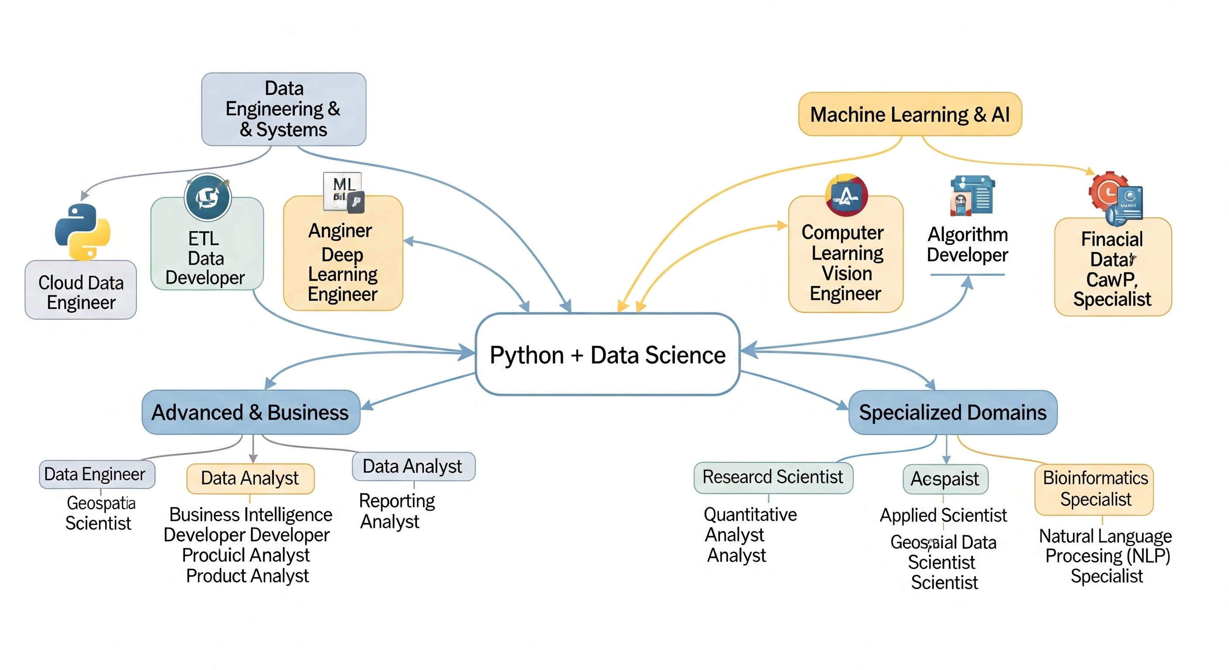
What we do After Python + Data Science

Slide 15
I
THANK YOU
For Listening

